Slide 1

Domain: MATLAB
Technology: COMMUNICATION
ECG-BASED BIOMETRIC AUTHENTICATION USING EMPIRICAL MODE DECOMPOSITION AND SUPPORT VECTOR MACHINES

Slide 2
Index
Abstract
Objective
Introduction
Literature review
Existing Method
Disadvantages
Proposed method
Advantages
Applications
Results
Conclusion
Hardware and Software Requirements
References

Slide 3
Abstract
An electric indication of heart activity known as an electrocardiogram (ECG) has highly discriminative qualities related to human recognition. Despite the recent success of ECG-based authentication, discriminant feature extraction and effective pattern classification still face several difficulties. An innovative methodology for an ECG-based biometric authentication system was put forth in this research. The suggested technique initially uses empirical mode decomposition to denoise a single lead raw ECG data (EMD). EMD is also used to extract the region of interest from ECG data that contains the most recognizable distinctive information about the subject. Then, five features from the statistical, time, and frequency domains are combined to extract features. Finally, a variety of classification techniques, including Support Vector Machines (SVM), K-nearest neighbour (KNN), and Decision Trees, were used to classify a subset of the features (DT).
Keywords—Biomedical recognition system, Electrocardiogram, Biometric authentication, Empirical mode decomposition, Support vector machines, Feature extraction.

Slide 4
Objective
Our main objective is to authenticate people based on their respective ECG signal
For that, we are implementing SVM classifier for classification.

Slide 5
Introduction:
Biometrics has emerged as a key instrument for authentication and identification in the modern world of automation and technology. A biometric system's complete reliance on the individual is one of its main advantages. In parallel with the use of fingerprints and facial recognition for this reason, medical biometrics, a new type of biometrics, are gaining popularity. Medical biometrics employ biological signals like the electrocardiogram to accomplish the same identification and authentication goals (ECG).The qualities that are specific to one person and serve as a basis for differentiating that person from the rest of the population are known as biometric features. The ECG is the best medical signal for this purpose out of all of them since each individual's ECG is unique, and this individuality may be taken advantage of by examining various ECG features. One of the biggest benefits of using an ECG biometric system is that it also ensures the person's presence and aliveness. In addition, it is very difficult to forge compared to a person's fingerprint, which can be forged, voice recording while a person is away, and iris images for iris-based recognition, but such techniques cannot be used with ECG biometrics.

Slide 6
Literature review:
S. NO | Journal Type with year | Authors | Title | Outcomes
1 | IEEE Internet of Things Journal, 2019. | P. Huang, L. Guo, M. Li, and Y. Fang, | "Practical Privacy preserving ECG-based Authentication for IoT-based Healthcare," | Practical Privacy preserving ECG-based Authentication
2 | 2018 IEEE International Conference on Big Data (Big Data), 2018, pp. 4984-4993: IEEE | S. S. Abdeldayem and T. Bourlai | "ECG-based Human Authentication using High-level Spectro-temporal Signal Features" | ECG-based Human Authentication using High-level Spectro-temporal Signal Features
3 | ECG, 2005 | T. S. J. P. Lugovaya, | "Biometric human identification based on ECG" | Biometric human identification based on ECG
4 | EURASIP Journal on Advances in Signal Processing 2010 (2010) | J. S. Arteaga-Falconi, H. Al Osman, A. J. I. T. o. I. El Saddik, and Measurement. | "ECG authentication for mobile devices" | ECG authentication for mobile devices
5 | ECG, 2011 | Y. N. Singh and S. K. Singh | "Evaluation of electrocardiogram for biometric authentication” | Evaluation of electrocardiogram for biometric authentication

Slide 7
Literature Review 1
In current healthcare systems, patients use various types of medical Internet of Things devices for monitoring their health conditions. The collected information (personal health records) will be sent back to hospitals for diagnosis and quick responses. However, severe security and privacy leakages with regard to data privacy and identity authentication are incurred because the monitored health data contains sensitive information. Therefore, the data should be well protected from unauthorized entities. Unfortunately, traditional cryptographic approaches or password-based mechanisms cannot fulfill the privacy and security demands in health monitoring due to their low efficiency and knowledge-based property. Biometric authentication overcomes these deficiencies and successfully verifies the inherent characteristics of humans. Among all biometrics, the electrocardiogram (ECG) signal is the most suitable one due to its medical properties. However, the security and privacy objectives of ECG-based authentication usually fail in practice due to the noise interferences in the collected ECG data and the privacy breach of the ECG database.

Slide 8
Literature Review 2
In this paper, we propose a novel approach that exploits the spectro-temporal dynamic characteristics of the ECG signal to establish personal recognition system using both short-time Fourier transform (STFT) and generalized Morse wavelets (CWT). This process results in enriching the information extracted from the original ECG signal that is inserted in a 2D convolutional neural network (CNN) which extracts higher level and subject-specific ECG-based features for each individual. To validate our proposed CNN model, we performed nested cross-validation using eight different ECG databases. These databases are considered challenging since they include both normal and abnormal heartbeats as well as a dynamic number of subjects. Our proposed algorithms yield superior performance when compared to other state-ofart approaches discussed in the literature, i.e. the STFT-based one achieves an average identification rate, equal error rate (EER), and area under curve (AUC)

Slide 9
Literature Review 3
This research investigates the feasibility of using the electrocardiogram (ECG) as a new biometric for human identification. It is well known that the shapes of the ECG waveforms depend on human heart anatomic features and are different for different persons. But it is unclear whether such differences can be used to identify different individuals. This research demonstrates that it is possible to identify a specific person in a predetermined group using a one-lead ECG. A one-lead ECG is a one-dimensional, low-frequency signal that can be recorded from electrodes on the hands. ECG fragments containing QRS complex, P and T waves extracted from the ECG are processed by principal component analysis and classified using linear discriminant analysis. Using this method on a predetermined group of 90 subjects, the experimental results showed that the rate of correct identification was 96%.

Slide 10
Literature Review 4
Traditional mobile login methods, like numerical or graphical passwords, are vulnerable to passive attacks. It is common for intruders to gain access to personal information of their victims by watching them enter their passwords into their mobile screens from a close proximity. With this in mind, a mobile biometric authentication algorithm based on electrocardiogram (ECG) is proposed. With this algorithm, the user will only need to touch two ECG electrodes (lead I) of the mobile device to gain access. The algorithm was tested with a cell phone case heart monitor in a controlled laboratory experiment at different times and conditions with ten subjects and also with 73 records obtained from the Physionet database. The obtained results reveal that our algorithm has 1.41% false acceptance rate and 81.82% true acceptance rate with 4 s of signal acquisition. To the best of our knowledge, this is the first approach on mobile authentication that uses ECG biometric signals and it shows a promising future for this technology. Nonetheless, further improvements are still needed to optimize accuracy while maintaining a short acquisition time for authentication.

Slide 11
Literature Review 5
This paper presents an evaluation of a new biometric electrocardiogram (ECG) for individual authentication. We report the potential of ECG as a biometric and address the research concerns to use ECG-enabled biometric authentication system across a range of conditions. We present a method to delineate ECG waveforms and their end fiducials from each heartbeat. A new authentication strategy is proposed in this work, which uses the delineated features and taking decision for the identity of an individual with respect to the template database on the basis of match scores. Performance of the system is evaluated in a unimodal framework and in the multibiometric framework where ECG is combined with the face biometric and with the fingerprint biometric. The equal error rate (EER) result of the unimodal system is reported to 10.8%, while the EER results of the multibiometric systems are reported to 3.02% and 1.52%, respectively for the systems when ECG combined with the face biometric and ECG combined with the fingerprint biometric. The EER results of the combined systems prove that the ECG has an excellent source of supplementary information to a multibiometric system, despite it shows moderate performance in a unimodal framework. We critically evaluate the concerns involved to use ECG as a biometric for individual authentication such as, the lack of standardization of signal features and the presence of acquisition variations that make the data representation more difficult. In order to determine large scale performance, individuality of ECG remains to be examined.

Slide 12
Existing method:
The qualities that make a person distinct from the rest of the population—those that are biometric features—serve as the foundation for identification. Given that each person's ECG is unique and that this individuality can be taken advantage of by examining various ECG aspects, ECG is the best medical signal available for this use. The Sinoatrial Node (SA) of the heart produces electrical currents, which descend to the Atrioventricular (AV) node and then disseminate throughout the body as well as within the heart. With the aid of surface electrodes, it is possible to measure these electrical currents, also known as the ECG. ECG signal consists of P wave that represents atrial depolarization or more commonly known as contraction of atria. The QRS complex in ECG signal shows ventricular depolarization or ventricular contraction and T wave represents ventricular repolarization or ventricular relaxation. The authentication will be done using Random Forest Classifier.

Slide 13
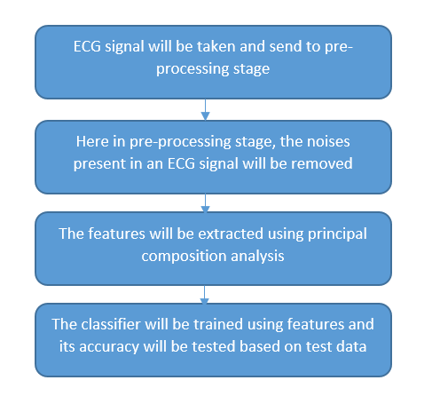
Fig. Block Diagram of Existing Method

Slide 14
Disadvantages in Existing methods:
It is most difficult to counterfeit as compared to fingerprint of a person which can be forged , voice recording of a person in his absence can be used and
Iris images can be used in iris based recognition but such tactics cannot be used in ECG biometrics.

Slide 15
Proposed method:
In this study, we used empirical mode decomposition (EMD) to isolate the region of interest from the raw ECG signal and remove artefacts. After that, meaningful and representative features from the time, frequency, and statistical domains are extracted. SVM-based classifiers performed best when a variety of classification techniques were used to assess the five features that were chosen. The remainder of the piece is organised as follows. A block diagram shows the proposed ECG-based biometric classification system in detail. Through EMD, data collected from ECG electrodes is preprocessed. Intrinsic mode functions are the sub-components of the input signal that are broken down by EMD (IMFs). From the ECG signal, which carries discriminative information about each person/subject, the region of interest is retrieved. By deleting certain signal components from the resulting preprocessed signal, redundant information and noise are removed.

Slide 16
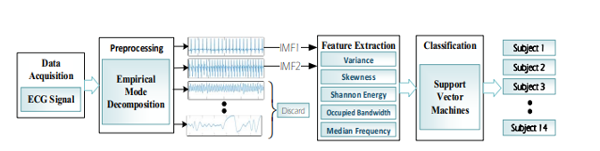
Proposed method:
FIGURE: Block Diagram of The Proposed Method

Slide 17
Advantages of Proposed method:
• Vector Machines (SVM) is widely applied as a best choice classifier for biomedical signal analysis applications.
• Empirical mode decomposition (EMD) is a recent and adaptive method that expands a signal into a compression of Intrinsic Mode Functions (IMFs).
• Bandwidth containing of the total integrated power of the transmitted spectrum, centered on the assigned channel frequency.

Slide 18
Applications:
1. Applied in DSP applications.
2. ECG Peak Detection.
3. Bio-Medical Signal Processing.
4. Image Processing.

Slide 19
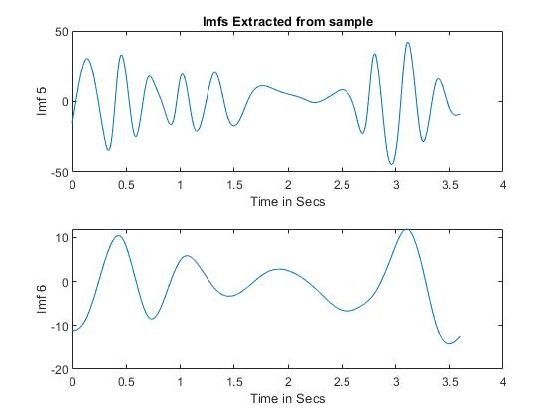
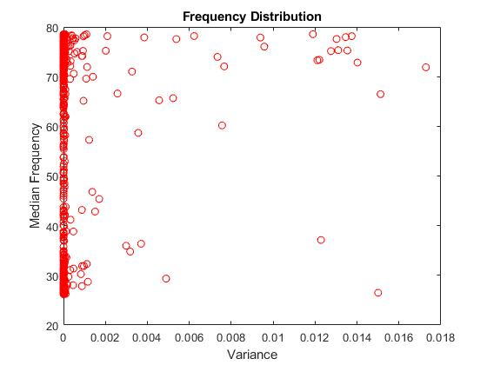
Results:

Slide 20
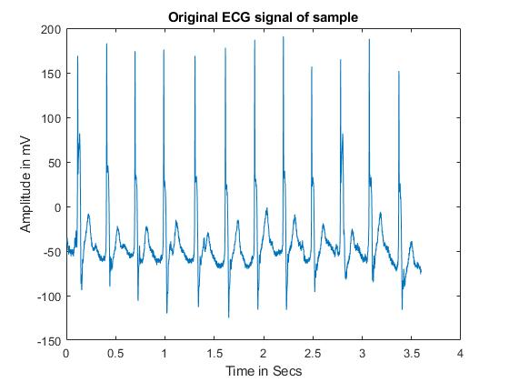
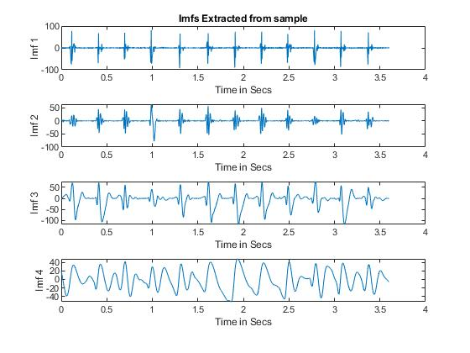
Results:

Slide 21
Conclusion:
This paper suggests a biometric authentication mechanism that uses ECG data. For signal denoising and region of interest extraction, the proposed method used EMD. To discriminate between distinct data classes, a combination of time, frequency, and statistical domain variables were retrieved. Eight different categorization techniques were used to assess a subset of features. SVM-C used a 10-fold cross validation approach to get the greatest classification accuracy of 98.72%. This study's data set was gathered from 14 distinct human participants. Experimental analysis demonstrates that the suggested strategy is more computationally efficient and computationally accurate when compared to other studies. In order to develop a more trustworthy solution for authentication, we intend to increase the dataset's size by gathering ECG signals from more participants in the future.
Based on the suggested methodology, we also want to create embedded systems for real-time biometric applications. such ingrained Systems can be employed in a variety of industries, such as banking and eHealthcare, to prevent the intrusion of medical information.

Slide 22
Hardware and Software Requirements:
Hardware & Software Requirements:
Software: Matlab R2018a.
Hardware:
Operating Systems:
• Windows 10
• Windows 7 Service Pack 1
• Windows Server 2019
• Windows Server 2016
Processors:
Minimum: Any Intel or AMD x86-64 processor
Recommended: Any Intel or AMD x86-64 processor with four logical cores and AVX2 instruction set support
Disk:
Minimum: 2.9 GB of HDD space for MATLAB only, 5-8 GB for a typical installation
Recommended: An SSD is recommended a full installation of all Math Works products may take up to 29 GB of disk space
RAM:
Minimum: 4 GB
Recommended: 8 GB

Slide 23
References:
P. Huang, L. Guo, M. Li, and Y. Fang, "Practical Privacy preserving ECG-based Authentication for IoT-based Healthcare," IEEE Internet of Things Journal, 2019.
[2] S. S. Abdeldayem and T. Bourlai, "ECG-based Human Authentication using High-level Spectro-temporal Signal Features," in 2018 IEEE International Conference on Big Data (Big Data), 2018, pp. 4984-4993: IEEE.
[3] T. S. J. P. Lugovaya, "Biometric human identification based on ECG," 2005.
[4] J. S. Arteaga-Falconi, H. Al Osman, A. J. I. T. o. I. El Saddik, and Measurement, "ECG authentication for mobile devices," vol. 65, no. 3, pp. 591-600, 2015.
[5] Y. N. Singh and S. K. Singh, "Evaluation of electrocardiogram for biometric authentication," 2011.
[6] M. K. Bashar, Y. Ohta, and H. Yoshida, "ECG-based biometric authentication using mulscale descriptors: ECG-based biometric authentication," in 2015 International Conference on Intelligent Informatics and Biomedical Sciences (ICIIBMS), 2015, pp. 1-4: IEEE.[3] T. S. J. P. Lugovaya, "Biometric human identification based on ECG," 2005.

